Slide 1
Online Safety Information Evening
Meeting will begin at 19:00

Slide 2
Online Safety Information Evening
Safer Internet Day 2021

Slide 3
Welcome
Plan for this evening
Apps to look/listen out for and why.
Current online trends/problems.
Press coverage of social media.
Internet security at WKGS.
E-Safety in the curriculum at WKGS.
Safer Internet Day 2021.
Data Privacy / Internet Safety / security tips.
Promoting healthy and responsible use of social media.
Useful sources of information/help with links.
Questions and Answers

Slide 4
Welcome
Mr Douthwaite
Head of Computing
Mrs Cliffe
Assistant Headteacher (Pastoral)

Slide 5
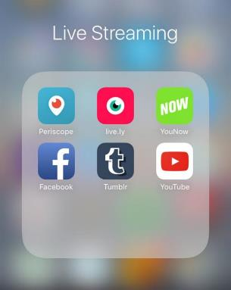
Apps to look/listen out for and why
Live Streaming Apps
Live streaming is the broadcasting in real time, it is when you record you or your surroundings to a live audience on the internet.
Live streaming is mostly done on a phone or tablet. It is a very popular thing to do because it gives you the chance to perform in front of an online audience.

Slide 6


Apps to look/listen out for and why
TikTok
Video-sharing. You can record and upload short video clips, watch other people’s videos, ‘follow’ people, gain ‘fans’, ‘like’ and comment
Age 13+
Children can be at risk of:
  Exposure to explicit or inappropriate videos, such as pornography and upsetting/harmful content, and age-inappropriate lyrics
  Strangers seeing videos they have shared, if their account is set to ‘public’; and anyone can see their profile information
  Contact from strangers asking to ‘trade’ explicit images/videos
  Feeling pressured to record inappropriate or explicit videos to gain more followers

Slide 7

Apps to look/listen out for and why
Snapchat
Picture, video and message-sharing with contacts. The ‘snap’ is on screen for up to 10 seconds, then disappears; or you can opt for no time limit. You can share snaps in a sequence for up to 24 hours
Age 13+
Children can be at risk of:
  Grooming, as the app will share their location unless they use ‘ghost mode’ and strangers can send them messages/requests
  Image-sharing without their consent, as people can save screenshots of images they post before they ‘disappear’
  Sexting, via requests for sexual images from people they don’t know
  Bullying, through photos being posted with unkind comments

Slide 8

Apps to look/listen out for and why
Instagram
Picture and video-sharing. You can post content publicly or to ‘followers’, see content posted by others, ‘follow’ each other, ‘like’ posts, comment, and send messages
Age 13+
Children can be at risk of:
  Inappropriate contact from strangers, who can see and comment on their photos and videos if their account is set to ‘public’
  Exposure to upsetting or harmful material, such as images relating to eating disorders, self-harm and suicide
  Bullying, through fake accounts and unkind comments on posts
  Pressure to ‘look’ a certain way – it’s an image-centred app

Slide 9

Apps to look/listen out for and why
TikTok
WhatsApp
Instant messaging in one-to-one and group chats, and calls. Allows you to send messages, images, videos and your location
Age 16+
Children can be at risk of:
  Bullying, e.g. directly in a group chat, or by being excluded from a group
  Sexting, as they can send and receive explicit photos
  Grooming, if they share their location
  Using it below the minimum age

Slide 10
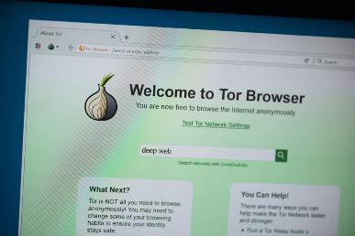
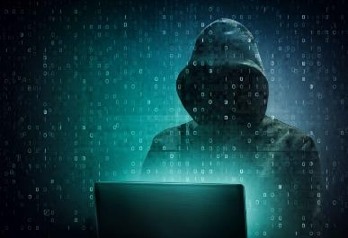
Apps to look/listen out for and why
The “Dark Web”
Using “TOR” browser to access the Internet anonymously.
Access ‘hidden’ websites.
Sale of illegal items
Exchange of illegal images/videos/
Used for illegal communication – Grooming/radicalisation.
Not illegal to access the dark net.
Simple to gain access, no specialist equipment needed.

Slide 11
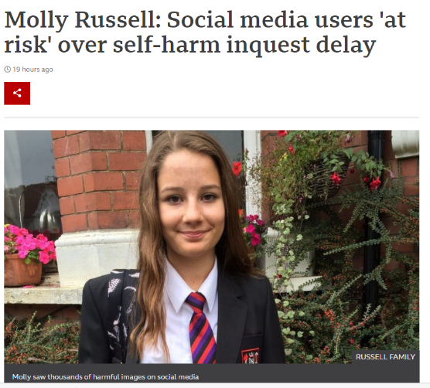
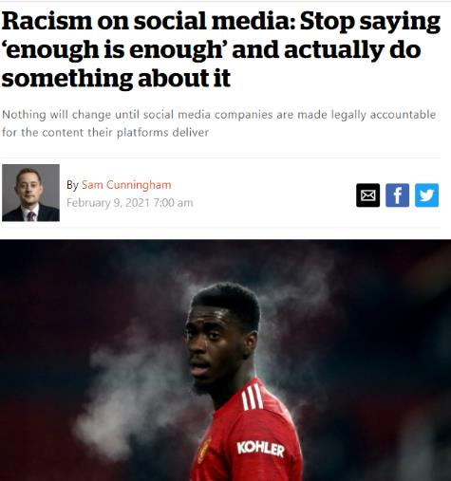
Press coverage of social media

Slide 12
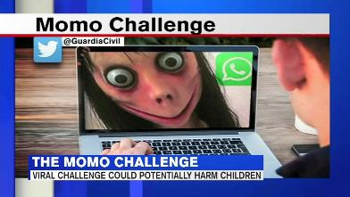
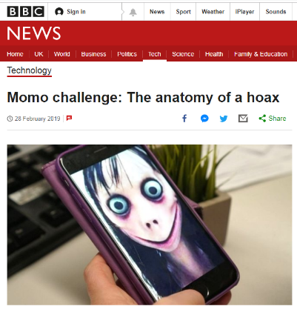
Press coverage of social media
“Momo Challenge”
Lots of coverage in the press and media.
Lots of information spread via social media and other ways.
Uncovered as a hoax.

Slide 13
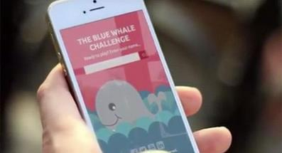
Press coverage of social media
“Blue Whale Challenge”
"All of these 'curators‘ turned out to be children aged 12 to 14."
Far from being manipulative adults, all the curators seemed to be just kids who had read or heard about the game.
Research suggests that the "challenge" might not have really existed in any substantial way before the newspaper article was published.
Most of the "curators" were copycats, acting out step by step the parts of a game that was being widely reported in the press.

Slide 14
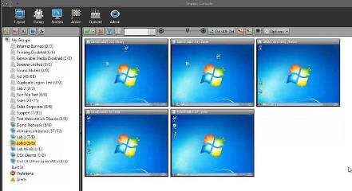
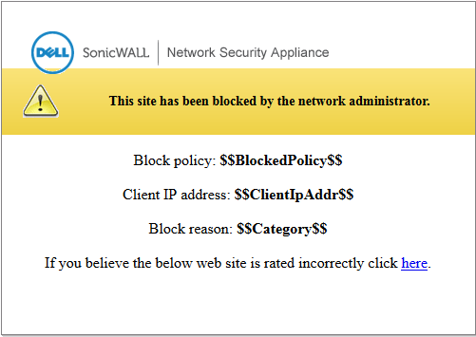
Internet security at WKGS
Impero – Network Management Software
SonicWall – Content Filter Software
Monitors website use and words typed.
Flags up ‘suspicious’ terms.
Records (potential) misuse.
Blocks websites which have been
reported to have inappropriate content.
Can be overridden by staff password
if the site is to be used in a lesson.

Slide 15
E-Safety curriculum at WKGS
Online safety is part of the curriculum in Computing at WKGS and is taught across
a number of other subject areas including Impact Days and form time activities.
In the Computing curriculum we focus at KS3 on safe Internet use, data privacy
and potential online threats.
Key Stage 4 pupils learn about legislation surrounding the use of computing
technology and about the methods used to detect and prevent online threats.

Slide 16
E-Safety curriculum at WKGS
Online safety is part of the curriculum in Computing at WKGS and is taught across
a number of other subject areas including Impact Days and form time activities.
In the Computing curriculum we focus at KS3 on safe Internet use, data privacy
and potential online threats.
Key Stage 4 pupils learn about legislation surrounding the use of computing
technology and about the methods used to detect and prevent online threats.

Slide 17
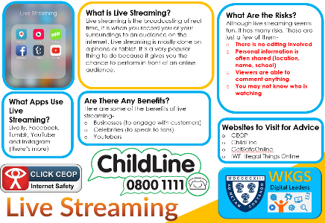
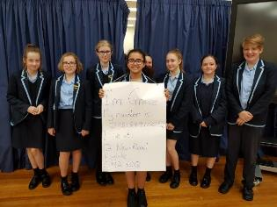
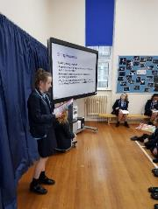
E-Safety curriculum at WKGS
Peer Education: Digital Leaders
Peer led E-Safety campaign run by Childnet.
Pupils from Year 9-11 involved (at the moment).
Pupils receive online training and reward badges
Half termly ‘themes’ to promote/raise awareness of…
The dangers of live streaming apps, Fake news, privacy.
Dangers of Live Streaming Poster
Delivering Year 7 online safety assembly

Slide 18
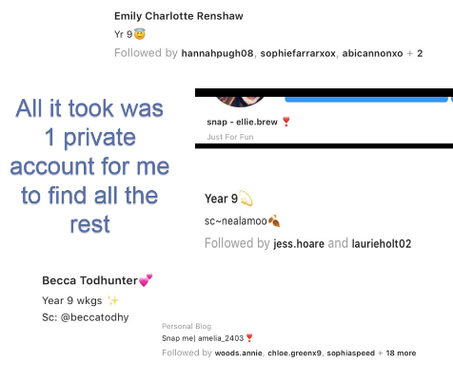
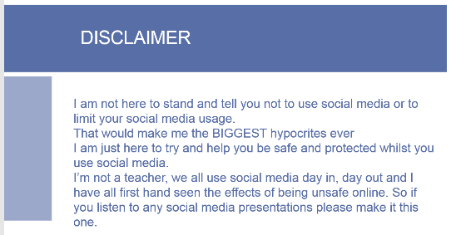
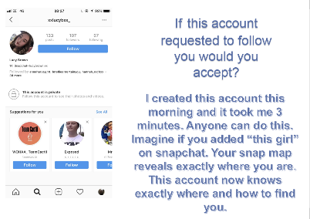
E-Safety curriculum at WKGS
Peer Education: Student Led Assemblies
Planned and delivered by a Year 12 student, following her
own experiences with social media.

Slide 19



Safer Internet Day 2021
An Internet we trust: Exploring reliability in the online world

Slide 20
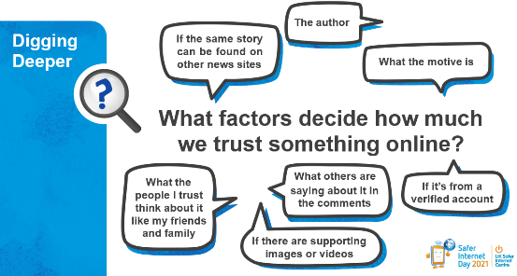
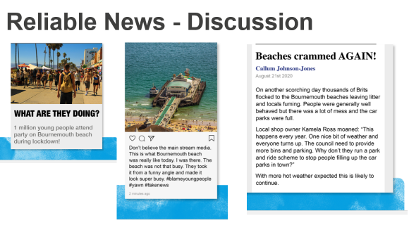
Safer Internet Day 2021
An Internet we trust: Exploring reliability in the online world
Fake News
How to spot fake news.
Questions to ask about reliability
Consequences of spreading misinformation

Slide 21
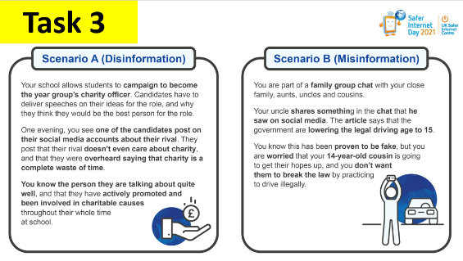
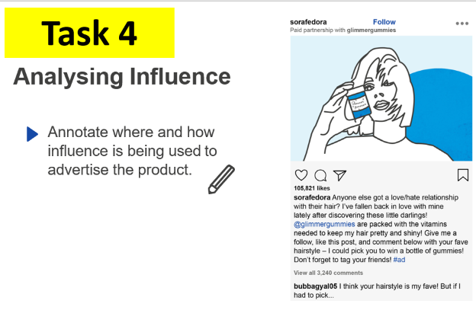
Safer Internet Day 2021
An Internet we trust: Exploring reliability in the online world
The role of influencers
Trustworthiness of online posts
Online advertising

Slide 22
Internet safety/security tips
Safer Internet Day – Taught Content

Slide 23


Internet safety/security tips
Privacy / Big Data / Digital Footprints
What happens to all of the information you share online?
Some may get shared again by someone else
It might stay with the person you intended to see it and them alone
Someone else could take a screenshot
Some of it is stored and analysed by certain apps and websites
This then can be used to form ‘Big Data’

Slide 24
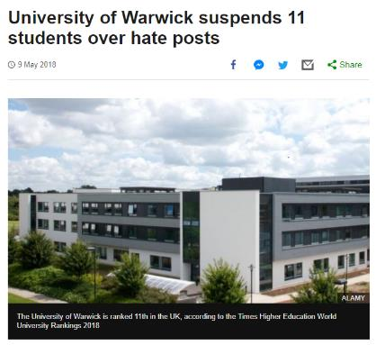
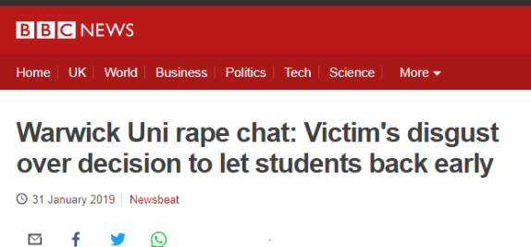
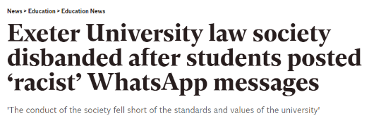

Internet safety/security tips
Privacy / Big Data / Digital Footprints

Slide 25

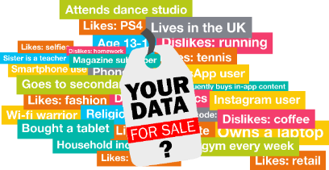
Internet safety/security tips
Privacy / Big Data / Digital Footprints
“Extremely large data sets that may be analysed computationally to reveal patterns, trends, and associations, especially relating to human behaviour and interactions.”
(Oxford Dictionary)
‘Big data’ can give you a tailored experience online- this might be showing you adverts or relevant to the things you like for example, a brand of shoes or clothing.
It might also be linked with your location so certain activities might appear in your timeline related to the area you live in.

Slide 26
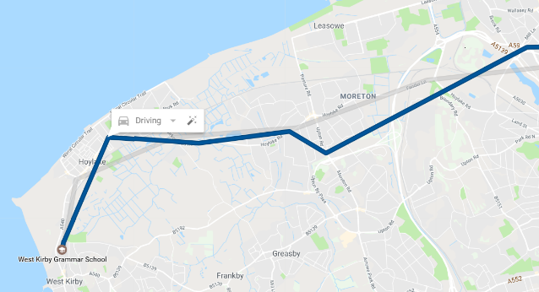
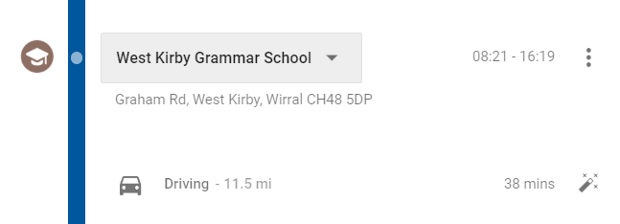
Internet safety/security tips
Privacy / Big Data / Digital Footprints

Slide 27
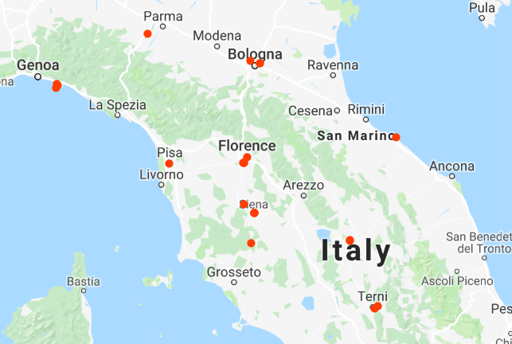
Internet safety/security tips
Privacy / Big Data / Digital Footprints

Slide 28
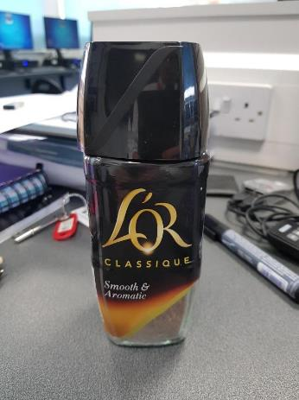



Internet safety/security tips
Privacy / Big Data / Digital Footprints

Slide 29
Internet safety/security tips
Privacy / Big Data / Digital Footprints
Here are some Top Tips for controlling your information
Think before you share - Think about what you are sharing and who can see it now and in the future
Explore your settings:
Who are you sharing your information with? - check which third party apps have access to your data and have a clean up of your followers
Withdraw permissions - Remove permission from any third party apps who do not need access to your account data
Download your data - have a look at what is being stored about you but remember to keep this safe!
Advertising preferences - modify your preferences within your settings so they reflect what you want them to
Delete - delete any content you no longer want and remove old accounts and apps

Slide 30

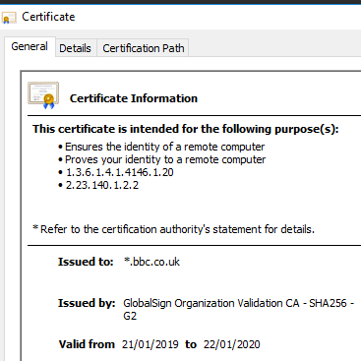
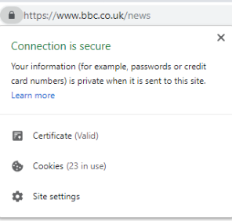
Internet safety/security tips
Internet Security
Secure Connections
Valid security certificate

Slide 31
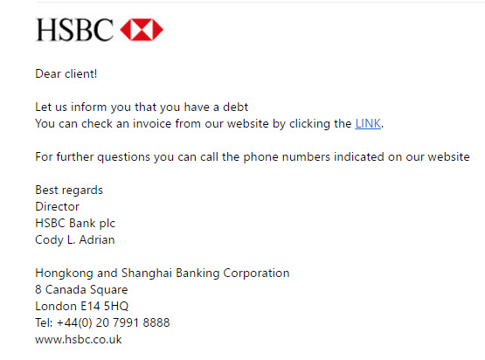
Internet safety/security tips
Internet Security
Phishing

Slide 32


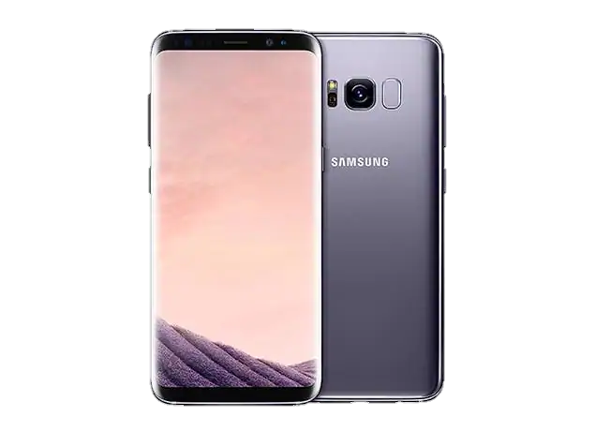

Internet safety/security tips
Internet Security
Don’t forget me!
Leave it!

Slide 33

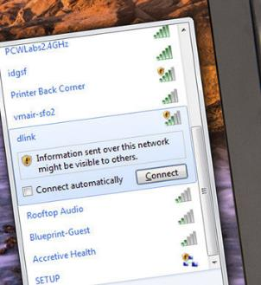
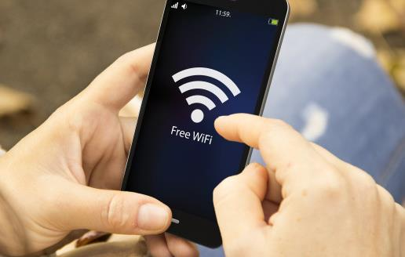
Internet safety/security tips
Internet Security
https://howsecureismypassword.net/

Slide 34
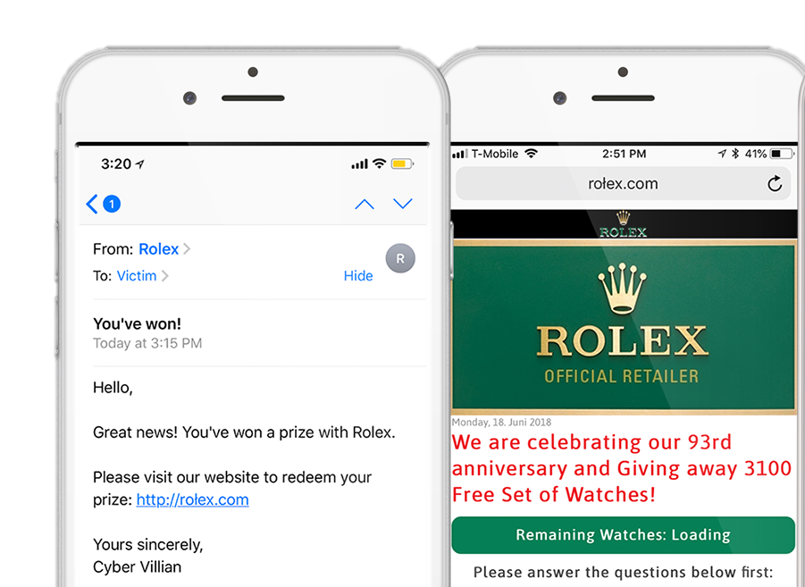
Internet safety/security tips
Internet Security – Homograph Phishing Attack

Slide 35
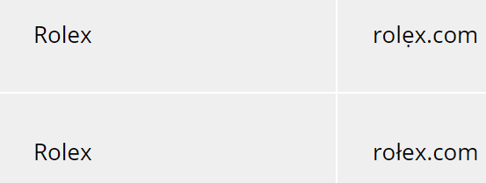
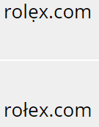
Internet safety/security tips
Internet Security – Homograph Phishing Attack
ẹ
Latin Alphabet
ł

Slide 36
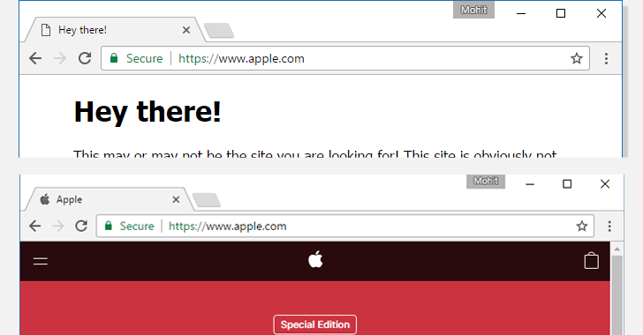
Internet safety/security tips
Internet Security – Homograph Phishing Attack
Cyrillic "а" (U+0430) and Latin "a" (U+0041) both are treated different by browsers
but are displayed "a" in the browser address.
You are being directed to a fake website. On initial glance, the URL appears genuine. It may even be a secure site with a digital certificate

Slide 37
Internet safety/security tips
Internet Security – Homograph Phishing Attack
Not a problem if you can identify it as a phishing email, even if the address looks genuine.
A common trick of this type of scam is to make you believe that you need to act quickly…”Offer valid for next 2 minutes” etc. They hope that you enter your details before you pay too close attention to site url.

Slide 38
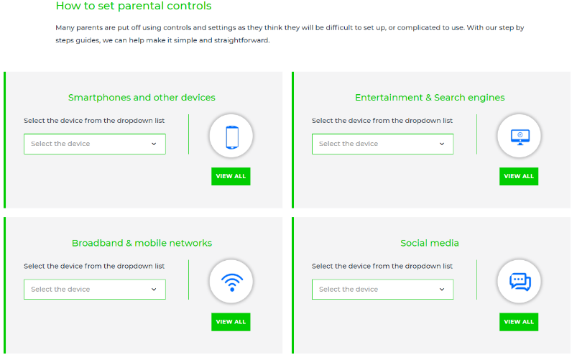
Promoting healthy and responsible use of social media
www.internetmatters.org

Slide 39
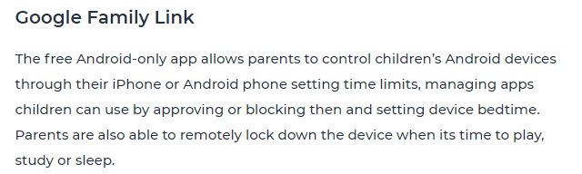
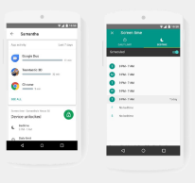
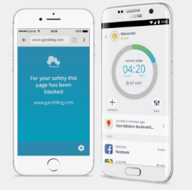
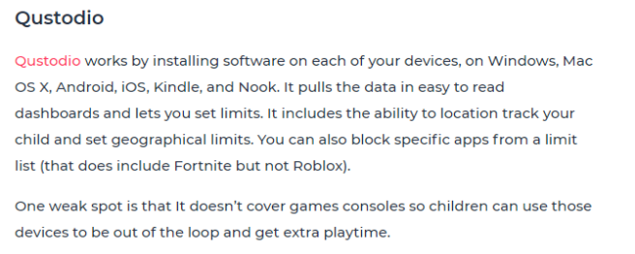
Promoting healthy and responsible use of social media

Slide 40
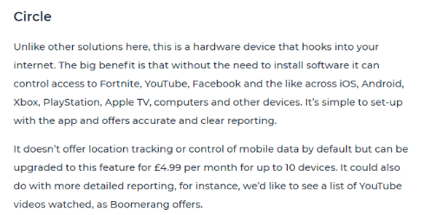

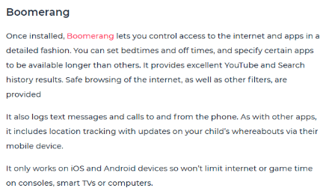
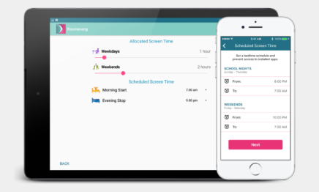
Promoting healthy and responsible use of social media
Monitoring systems

Slide 41
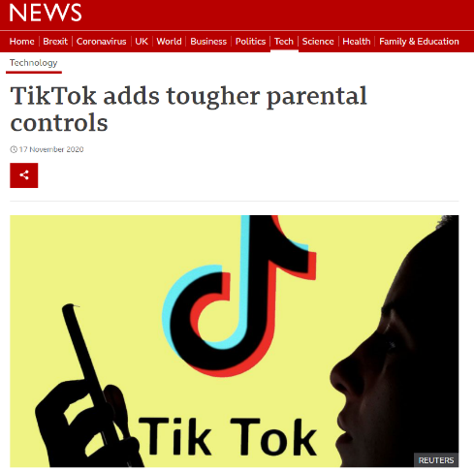
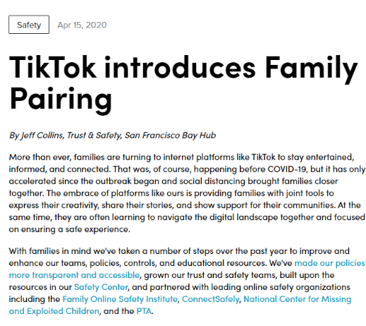
Promoting healthy and responsible use of social media
TikTok Family Pairing

Slide 42
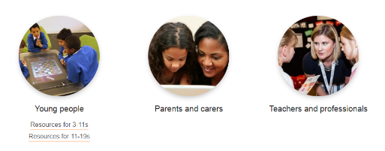

Useful sources of information for help/support with links
Safer Internet Centre
Childnet
https://www.saferinternet.org.uk/
https://www.childnet.com/

Slide 43
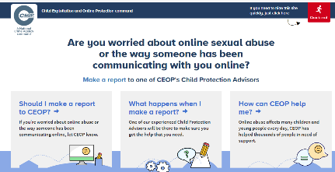

Useful sources of information for help/support with links
CEOP (Child Exploitation and Online Protection)
Internet Matters (Specifically for parents)
https://www.ceop.police.uk/safety-centre/
https://www.internetmatters.org/

Slide 44
Questions and Answers
We will now answer any questions submitted via Teams
Please note, we will not discuss individual pupils or individual cases
of internet/social media use/misuse. If you have any such concerns,
please raise them with your child’s head of year.

