Slide 1
Welcome to Year 12 Information Evening
16th September 2021

Slide 2

We are kind, considerate and help others. | We always give it our best and go for our goals. | We try new things to find our passions.
We explore new ideas and different ways to solve problems. | We want to continuously learn and expand our knowledge, | We keep going, even when things get tough.

Slide 3
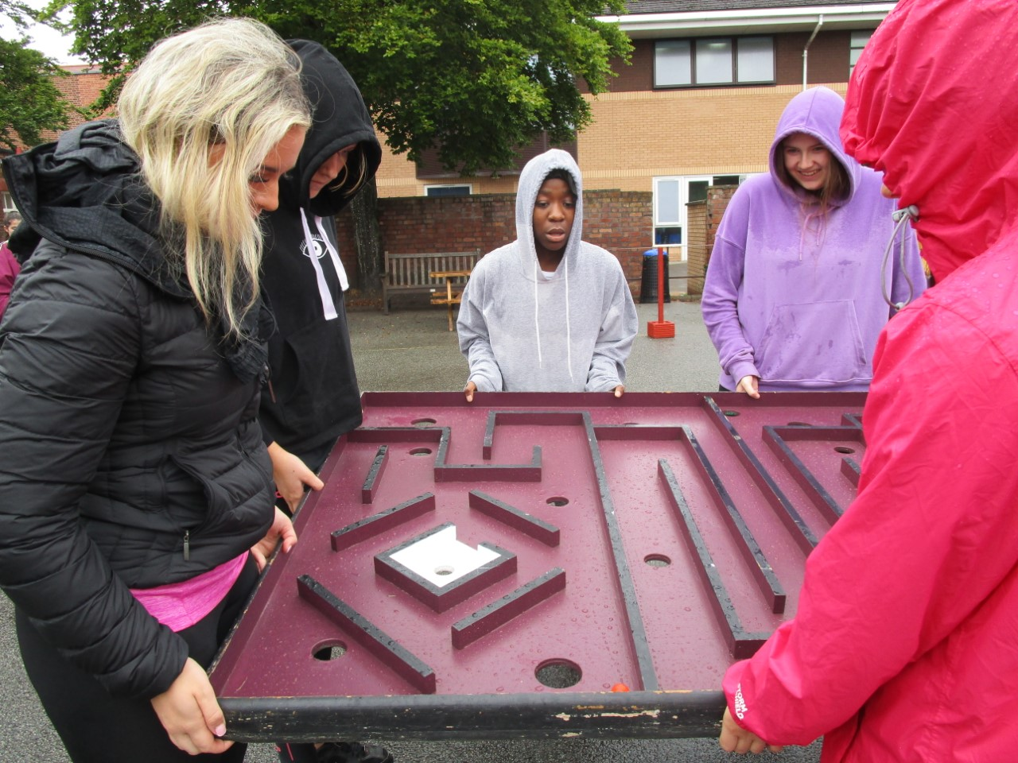
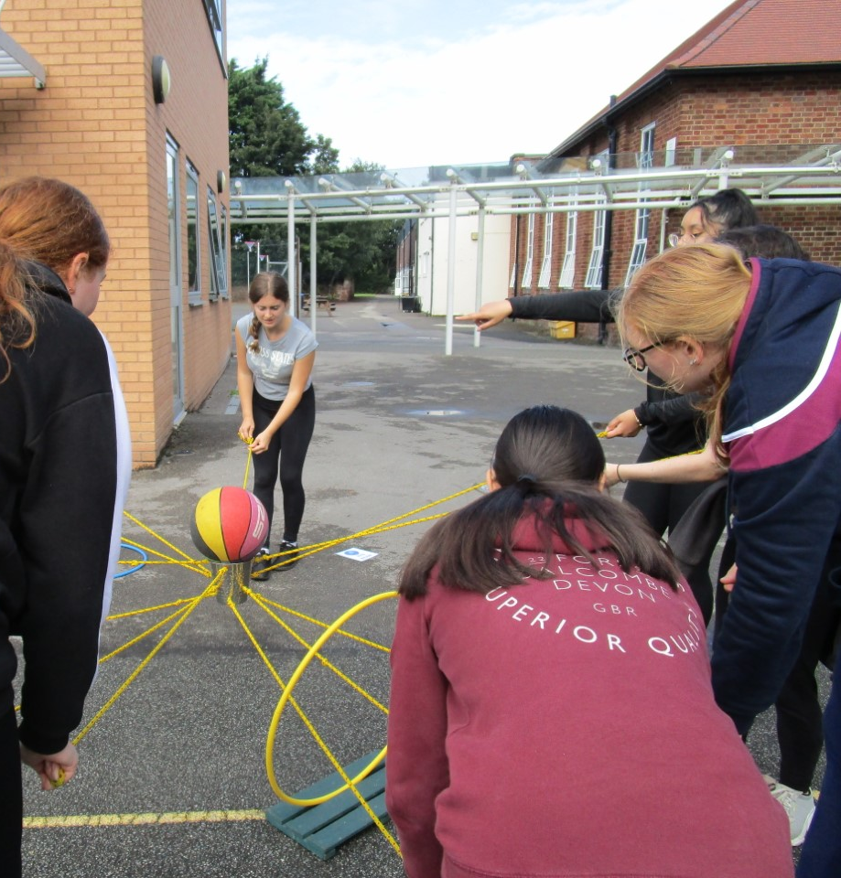
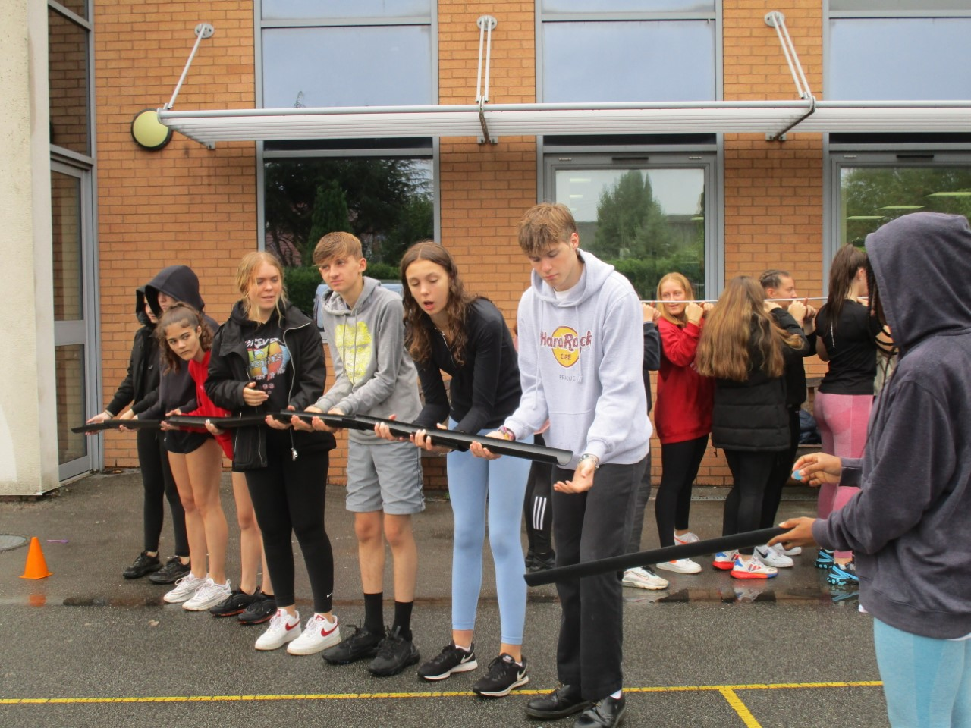
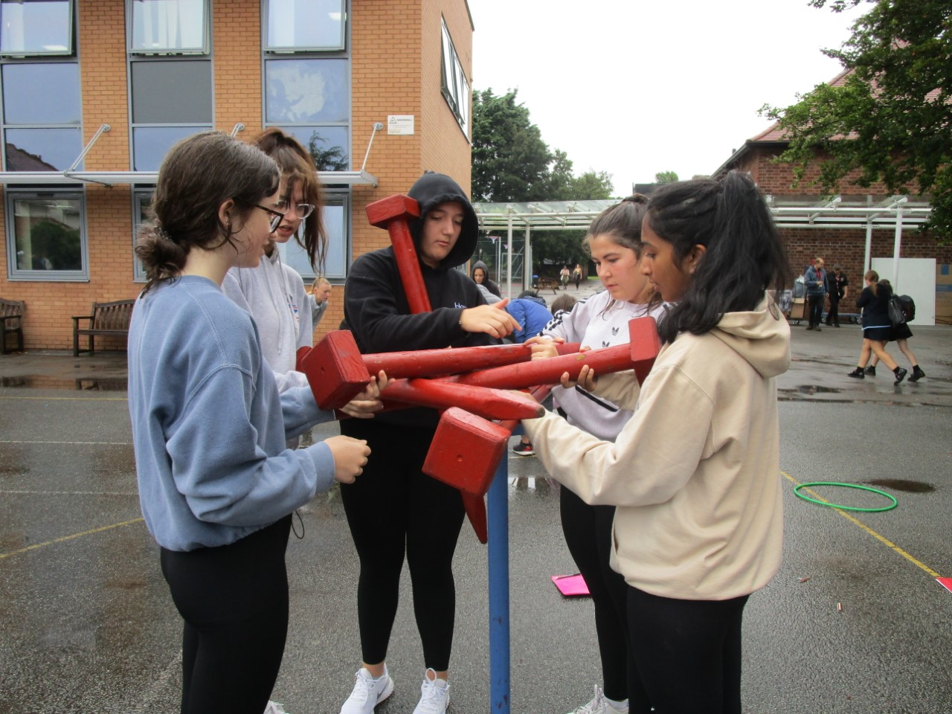
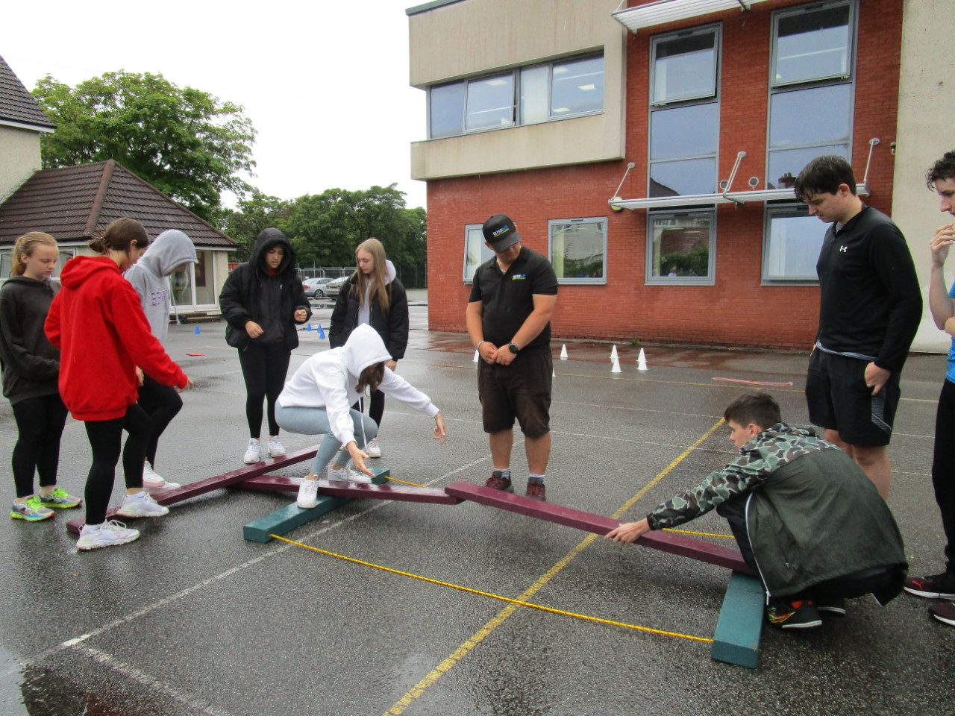
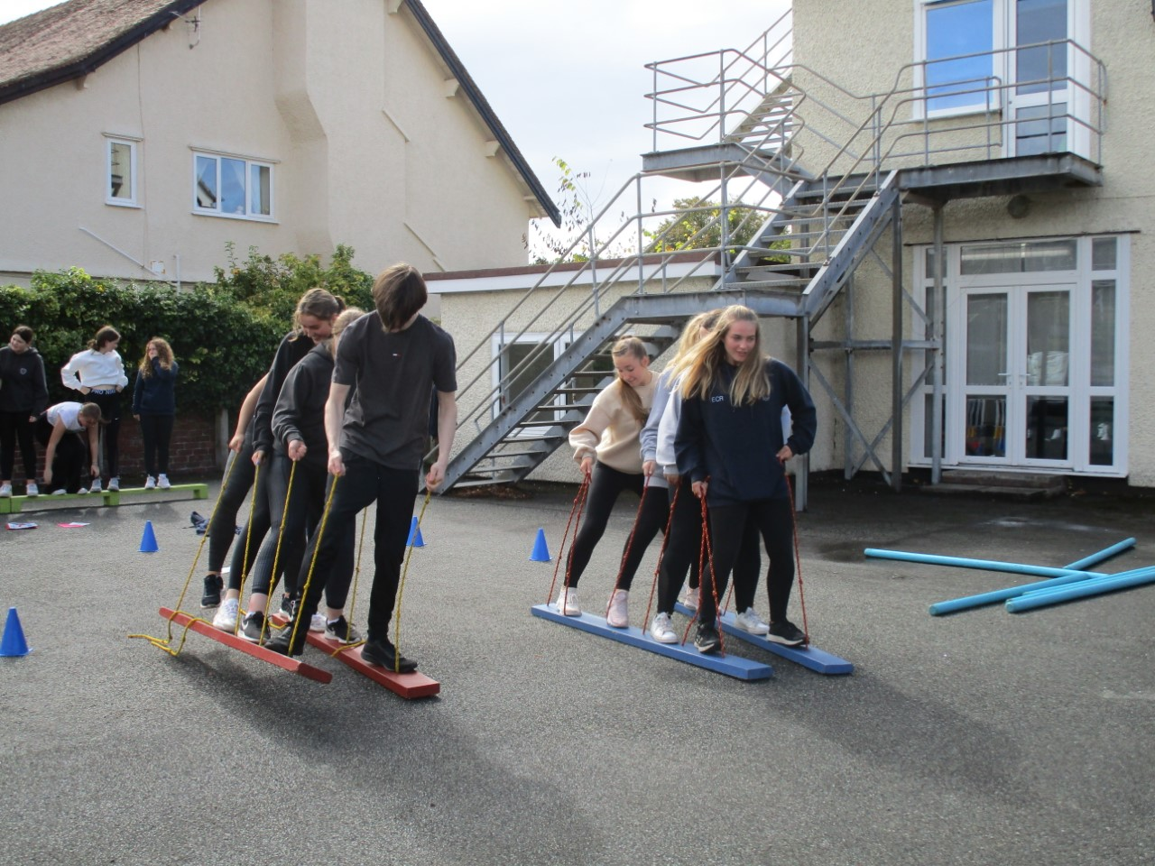
Induction days

Slide 4
Curriculum
Optional Curriculum
3 or 4 Subjects
Changing subject – deadline Friday 1st October 2021
Choosing AS (4th subject) – deadline Thursday 13th January 2022
The Core Curriculum
EPQ
Enrichment/Personal Development
Additional
Easedale study periods
Free periods
Form Time

Slide 5
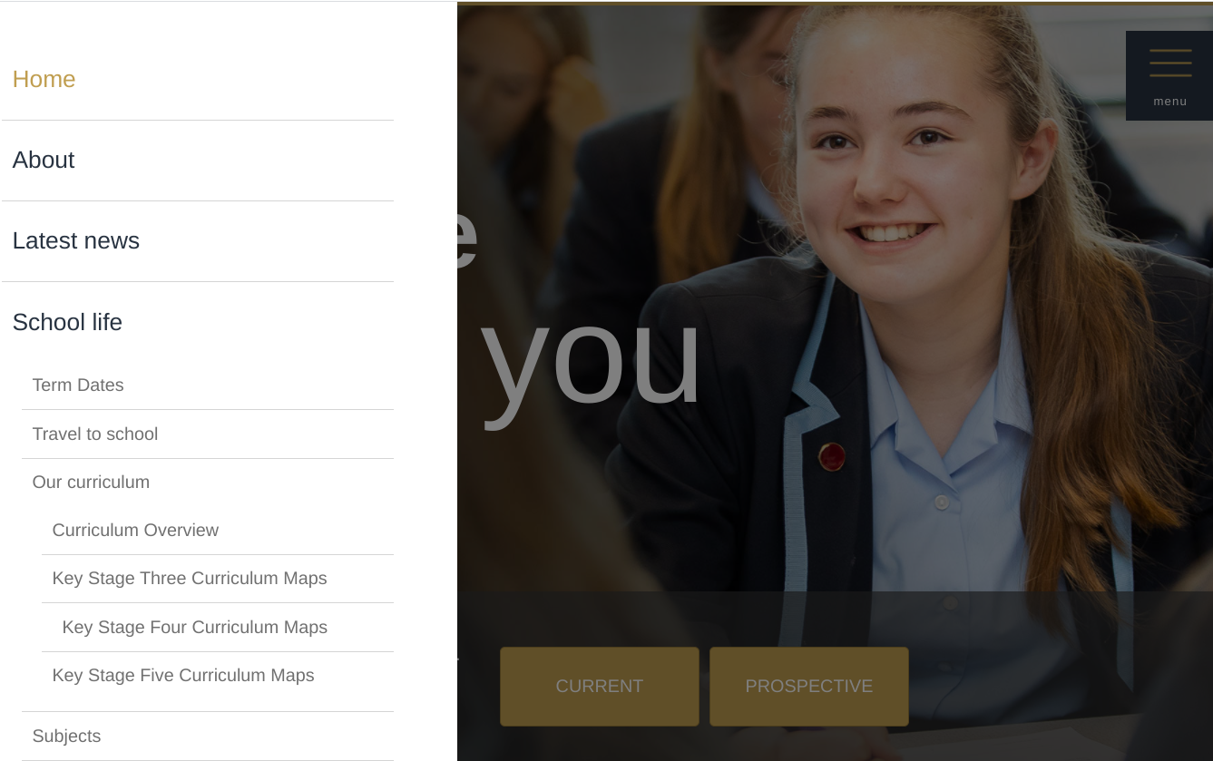
Curriculum Maps
>School life
>Our curriculum
>Key Stage Five Curriculum Maps
From 20th September

Slide 6
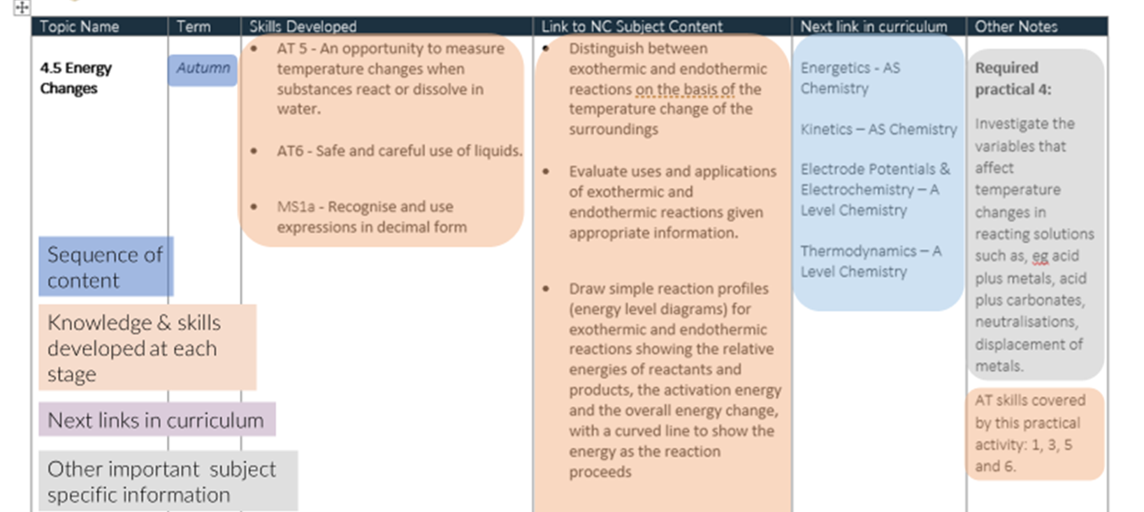
Curriculum Maps

Slide 7
Extended Project Qualification (EPQ)
Provides key skills that universities and employers are interested in
Independent learning – choice of topic and format (dissertation, investigation or fieldwork, production or artefact )
Exercise use of in-depth research and critical analysis
Additional qualification with UCAS points
Many Russell Group universities support & encourage

Slide 8
Enrichment Options
Y13
Italian Cookery
Self Defence
First Aid
Debating
Maths for Scientists
Yearbook Committee
Driving Lessons
Prom Committee
Fitness
Volunteering
EPQ
Y12
Ravin' Fit
GCSE Geology
Bar Mock Competition
Maths for Scientists
Sign Language
Football Skills
Knit n Knat (hats for special baby care unit)
Peer Educators with Y7 & Y8
Volunteering
EPQ

Slide 9

Personal Development
Personal development is when students learn more about their interests and work towards achieving them. During this process, they also build confidence.
Personal development is a powerful process that can enable deep positive and lasting change to how we see ourselves and see the world.
Personal development is the process of becoming yourself.

Slide 10

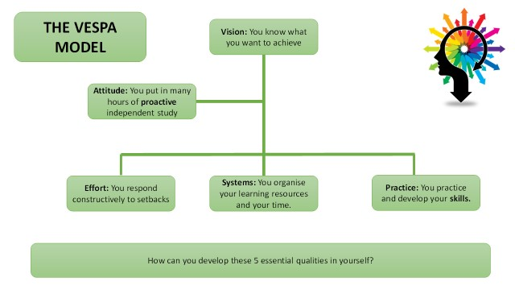
Enhancing Your Success Throughout Your A-Levels

Slide 11
Opportunities
Form Representatives
Peer Educators
Mental Health Ambassadors
Subject Mentors
Clubs – sports, music etc
Trips/workshops
Volunteering
Prefects/Head Prefect Team
House officials

Slide 12
Part-time employment
We recognise the importance of employment; building transferable skills, gaining experience, interaction with others, developing confidence and financial independence.
Social Time
Research nationally has shown that working up to 9 hours per week does not appear to influence examination grades
However, if employment exceeds 9 hours per week, research has shown that grades are lower for additional hours.

Slide 13
Student Support
Subject Staff & Form Tutors
Mrs Duffey (Head of Year 12)
Mrs Hughes (Head of Y13)
Mrs Harris-Smith (Assistant Head of Sixth Form: pastoral/EPQ & Enrichment Coordinator)
Mrs Marley (Assistant Headteacher: Sixth Form)
Mrs Cliffe (Assistant Head Teacher: Pastoral)
Mr Clarke (Head Teacher)
Mrs Hill-Jones (Examinations office)
Parents/guardians

Slide 14
Specialised Support
Debbie Lidgett (Student Wellbeing Manager) – in school
Kersti Lawson (Youth Worker)
Diana Ireland (School nurse)
Alex McStea (Counsellor)
Constable Scarratt (Safer schools police office)
Links with external agencies

Slide 15
Financial Support
NOTE: Applications will be assessed by the finance committee after the
deadline: 17th September 2021
Vulnerable Student Bursary – Up to £1200
- Care leavers
- Students in receipt of income support
Disabled students who receive Employment Support Allowance and
Personal Independence Payments (Disability Living Allowance)
Discretionary Bursary
Tier A – Up to £1000 per year
Household income less than £16,190 or in receipt of free school meals
Tier B – up to a maximum of £800 per year
Household income exceeds £16,190 but below £25,000

Slide 16
Careers Guidance
Dedicated Careers Library for Sixth Form
In house careers advisor (Mploy)
Links with Universities
UCAS exhibition and application support
Apprenticeships support
Work experience week in summer term
Interview support

Slide 17
Expectations
Independence
Attendance
Punctuality
Behaviour
Uniform

Slide 18
Independence
Manage independent time efficiently and develop study skills
Most Year 12 students have study periods in Easdale
Free periods – Sixth form areas
Directed Form time - study skills booklet (VESPA)
3 hours of private study per subject per week recommended
Students take responsibility for their own learning and experiences

Slide 19
Attendance and Punctuality
Attendance below 95% will generate letters/requests for parental appointments
Parents MUST notify school each day with reasons for absence
Three or more late marks per fortnight generates a detention
Record may be required for references (including UCAS)
Medical appointments – by request on completion of online form (via students intranet account) – evidence required
Leave of absence - one month in advance (if possible)
Open days & interviews – purple form
ALL paper forms must be completed and signed by parents and returned to the attendance officer in school or via email (jpugh@wkgs.net)

Slide 20
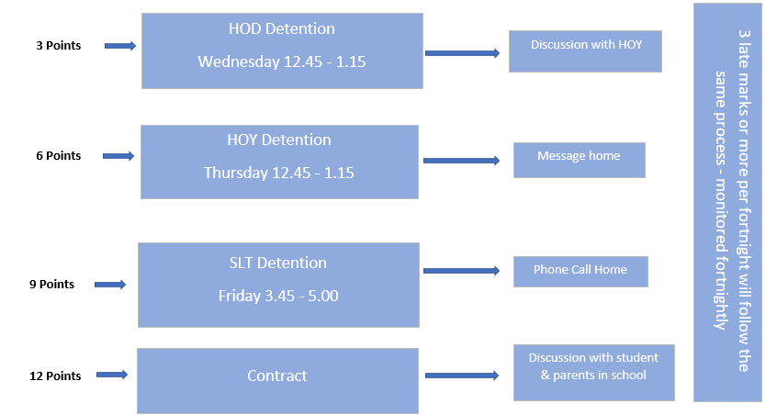
Sixth Form Conduct System

Slide 21
Sixth Form Dress Code
Not Appropriate for School
Jeans
Shorts
Tracksuit bottoms
Leggings
Tight fitting or short skirts
Crop tops
Tops with large logos
Strappy tops
Flip flops
Trainers
Blazer
Tailored trousers or skirt (appropriate in length)
Tops and shirts should be smart
Leather/leather effect shoes
Lanyard
Natural hair colour
Canvas shoes
No Facial piercings

Slide 22
Term | Year 12 | Year 13
Autumn 1 | Induction Parents’ information evening New student interviews Assessment period 1 starts | Final Completion of UCAS forms University entrance tests University Open Days Assessment Period 1
Autumn 2 | Assessment period 1 continues Short report issued GCSE certificate Presentation afternoon | Short report issued Parents evening University Interviews and Offers
Spring 1 | AS Decisions Assessment period 2 | Parents evening University Interviews and Offers Art Foundation Applications Completed
Spring 2 | Full reports issued Parents evening | Assessment period 2 (Mock examinations) Full reports issued
Summer 1 | AS external examinations | External examinations begin
Summer 2 | Assessment period 3 (EOY exam) Short Reports issued University Open Days Work Experience Draft completion of UCAS form and PS | External examinations continue Prom
August | AS results | A-level results UCAS clearing operates

Slide 23
Questions?
Name | Email
Mrs A Duffey: Head of Y12 | aduffey@wkgs.net
Mrs S Harris-Smith: Assistant Head of 6th Form (Pastoral) | sharris@wkgs.net
Mrs Marley: Assistant Head Teacher (Sixth Form) | lmarley@wkgs.net
Mrs Hughes: Head of Y13 | lhughes@wkgs.net

Slide 24
Thank you for your support

